Slide 1
disseminate SOMRAS

Slide 2
Ram rajya , praja sukhi
Ram, the most beloved king, the scion of ikshvaku , is the most favorite and famous king of Indian mythology.
He was the one who totally believed in statement
“FOR THE PEOPLE, BY THE PEOPLE, TO THE PEOPLE”
Following his tradition, lets distribute the vaccine namely SOMRAS (anti-aging drink) to his people for a noble cause.

Slide 3
Description
Get Ready , Vaccinators…….!!!
You are going to Launch the vaccination drive for betterment of Ayodhya and Ayodhyawasis.
Ayodhya has a population of 10k diversely spread within it.
For this drive Ayodhyawasi are divided predominantly in three groups namely Senior Citizens , children and adults (three groups are written in order of their priority).
We will be providing you plan of Ayodhya with pinned locations in it. Details of all the location along with description of population (i.e. number of Senior Citizens , Adults and Children ) will be in Excel Sheet attached to provided link.
You need to mark your route within 30 minutes satisfying all the conditions given below .
You need to open the file .pdf(or .jpg) and in edit option you can mark your route using marker . Lastly , submit it via Google forms ,Link will be uploaded in the chat. Strictly follow the time limit as we will stop accepting responses as soon as time gets over and no excuses will be entertained then.

Slide 4
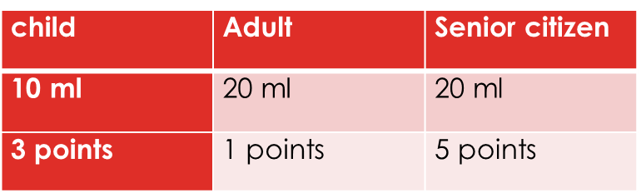
Conditions
Approach maximum number of people .
Only one hour is available for whole vaccination drive.
Time to provide somras to one person is 2 seconds.
Time taken to travel 1 m is 1 sec (Distance will be marked in plan).
Points to be allocated to all age grp are as follows

Slide 5
6. you need to reach out nearest health center once you are out of stock for collecting vaccine. You will get only 15 liter initially.
Every time you will get only 15 liters upon reaching out to health centers.
Your aim is to take shortest route covering maximum number of people in minimum amount of time.
Don’t confuse time of vaccination with time of submission of your answer. Both are different one which is with distance and number of people is for vaccination and second one i.e. time for submission provides you bonus points.
we will provide excel sheet where number of people will be specified at that particular location and all the conditions will be mentioned there also.

Slide 6
Judging criteria
P- Points accumulated according to priority.
P=3* C+1*A+5*S C=Children
A=Adult
S= Senior citizen
N- Number of people vaccinated .
N=C+A+S
D- Distance travelled .
T- Time taken .
T=N*2+D*0.1
Cumulative Total : P+N-D-T

Slide 7
Participant with
Highest number of cumulative total will be Winner ,
Second highest cumulative total will be 1st Runner –Up,
Third highest cumulative total will be 2nd Runner –Up.

Slide 8
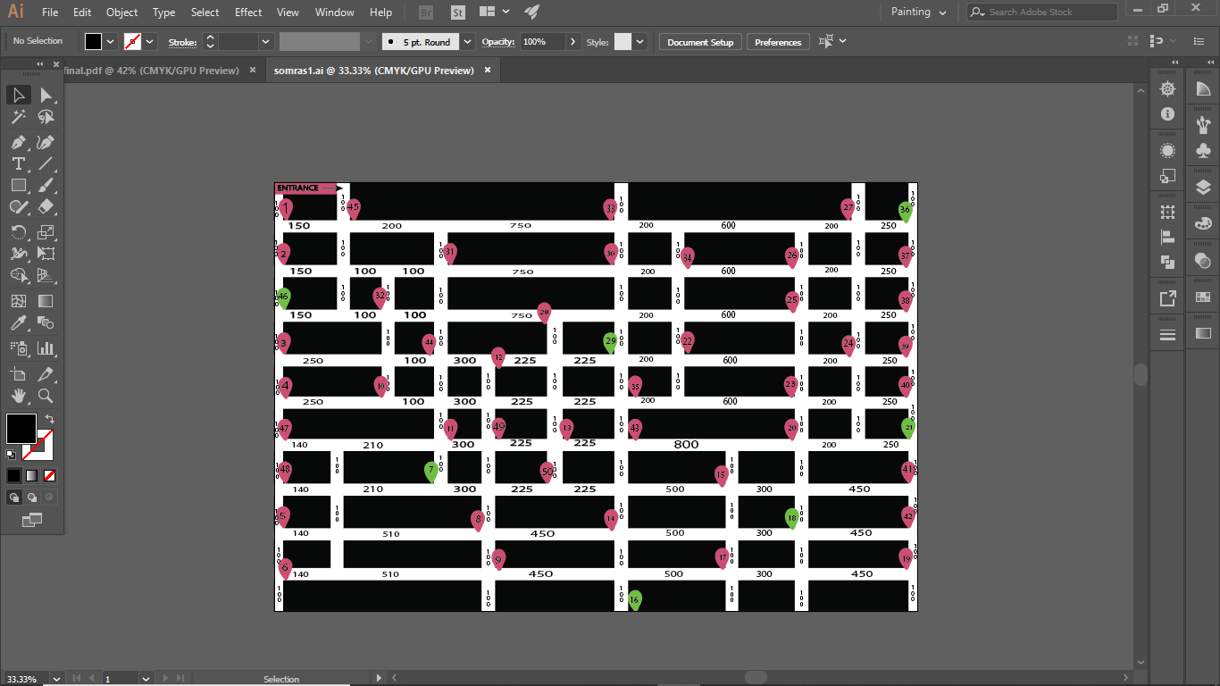

Slide 9
Prepared by : chintan patel rutvi shah somesh patidar vaibhav singh

